Slide 1
Visualizing Climate Change
Nataly Beribisky

Slide 2

What is climate change?
Long term weather averages can be known as “climate.” Climate has always changed.
Earth obtains almost all of the energy from the sun (and a very trace amount for the Earth’s centre).
Warming: when the amount energy going into the atmosphere is greater than the energy leaving it.
Cooling: when the amount of energy leaving the atmosphere is more than the energy entering it.

Slide 3

WHAT is climate change?
Greenhouse gases help keep the heat in the Earth’s atmosphere, allowing it to sustain the Earth’s biosystems. (Step 4)
But now, due to the excess of heat-trapping greenhouse gases (because of burning fossil fuels, tree-cutting, etc.) the earth’s temperature is changing at a faster rate than the past thousand years. (Steps 5 and 6)

Slide 4
“The race is now on between the technoscientific and scientific forces that are destroying the living environment and those that can be harnessed to save it. . . . If the race is won, humanity can emerge in far better condition than when it entered, and with most of the diversity of life still intact.”
― E.O. Wilson, The Future of Life
Notes:
American Biologist

Slide 5
How does visualization help?
Visualization helps to analyze and present climate simulations and observations along with data related to the ecological and social factors regarding climate change (Nocke, Sterzel Böttinger & Wrobel, 2008)
Increased data: (Nocke et al,. 2008)
Greater computation power allows simulations to be generated to recreate past climate patterns and predict future ones.
Data from satellite operations from space.

Slide 6
Potential challenges
Heterogenous data
Heterogenous user-groups
Different skills, qualifications, interests, disciplines
Questionnaire of 76 researchers at Postdam Institute for Climate Impact Research about what they use their visualizations are for:
What Visualization is Used For | Proportion of researchers that use them for that purpose
Presented in a scientific context | 93%
Model Evaluation | 76%
Verify Hypothesis | 70%
Explore unknown patterns and structures | 69%
Make results comprehensible to decision makers, stakeholders, media | 58%
Nocke et al. (2008)

Slide 7

Potential challenges
What are the consequences of using the same visualization for heterogenous user-groups?
Does it make sense to use the same visualization for a climate scientist and a member of the general public when talking about climate change?
Why or why not? Would it depend on the visualization?
Would you change a data visualization you have used at a conference if you were giving a public lecture on the same topic?

Slide 8
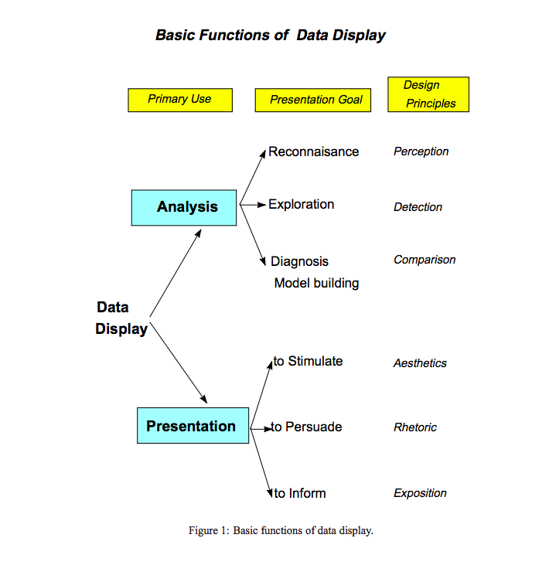
Visualizations and their intent
What Visualization is Used For | Proportion of researchers that use them for that purpose
Presented in a scientific context | 93%
Model Evaluation | 76%
Verify Hypothesis | 70%
Explore unknown patterns and structures | 69%
Make results comprehensible to decision makers, stakeholders, media | 58%
(Friendly, 2000)

Slide 9
CLIMATE VISUALIZATIONS AND THEIR INTENT
TYPE OF RESPONSE TO IMAGERY
SPECTRUM OF RESPONSES TO CLIMATE CHANGE
Behavioural response
(intense affective and cognitive responses motivate behavioural change)
Affective response
(emotions are engaged)
Cognitive response
(improved or accelerated understanding)
People change their behaviour to mitigate and adapt to climate change
People change their minds (register the intent to act) on the need to mitigate and adapt to climate change
People feel emotionally the need to mitigate and adapt to climate change
People understand the need to mitigate and adapt to climate change
People acknowledge the issue but ignore or deny the need to mitigate and adapt to climate change
People are unaware of the need to mitigate and adapt to climate change
(Sheppard, 2005)

Slide 10
How do we do this?
1. Disclosure : a window into the future which is personally meaningful and tangible, making the global both local and personal, putting scientific information into understandable forms and contexts, and showing possible negative and positive outcomes;
2. Drama : a vivid and compelling presentation with emotional content, landscape realism, and intensity of engagement in the display media; and
3. Defensibility: a systematic and credible process that enables transparency and trust in the presenters and underlying information.
(Sheppard, Shaw, Flanders & Burch, 2008)

Slide 11
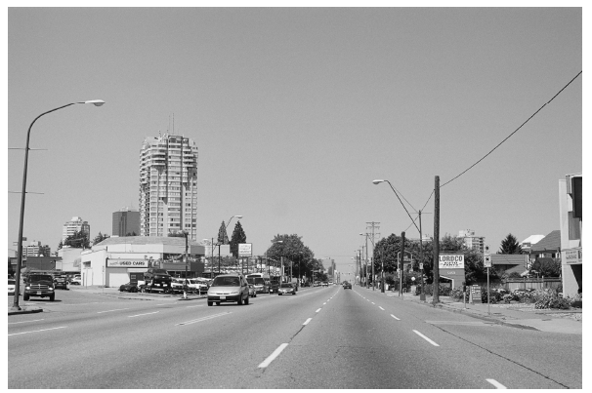
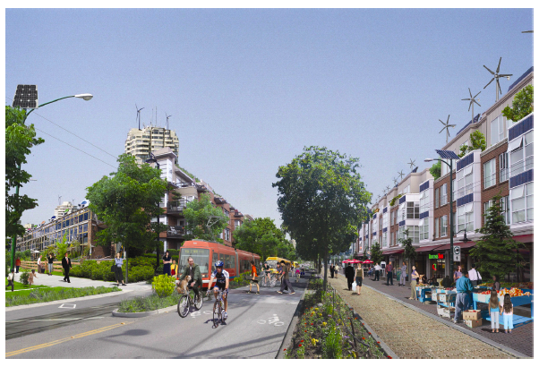
LANDSCAPE VISUALIZATIONS
2A
2B
Fig. 2a: Existing conditions in a high-carbon urban landscape.
Fig. 2b: Conceptual visualisation of a low-carbon future with intensive mitigation (eg. transit corridors, walkable neighbourhoods, live-work buildings, energy efficient design, energy-generating buildings, etc.) and adaptation (increased summer shade, local food production, etc.). Credit: David Flanders, CALP/DCS, UBC.

Slide 12
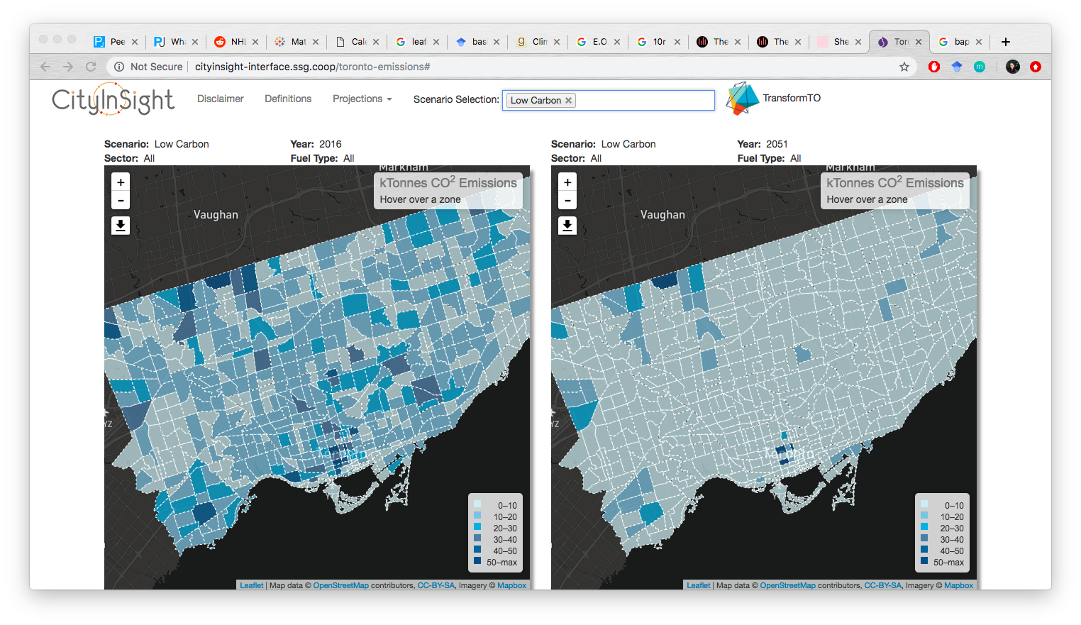
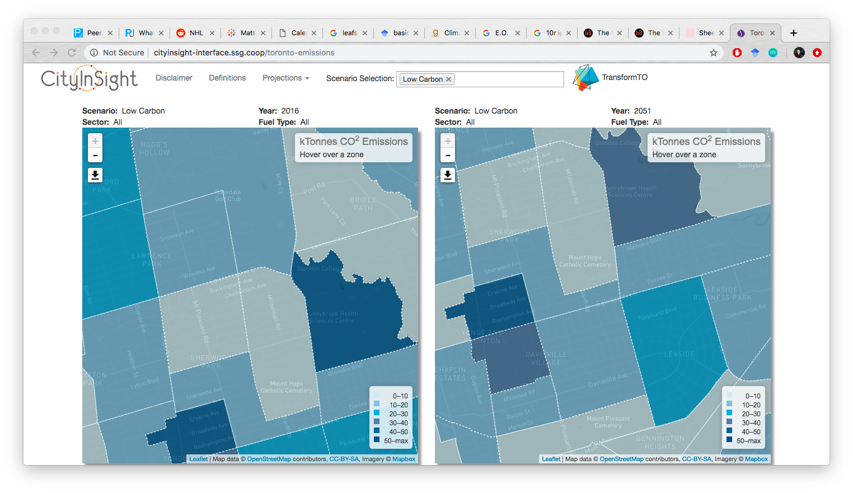
City insight transformto

Slide 13
Common DATA visualizations TECHNIQUES
Commonly used techniques are: time charts, bar charts, 2D maps, scatterplots.
2.5D and 3D visualizations are considerably less frequent.
Commonly climate data is visualized to demonstrate temporal trends with a time chart.

Slide 14
temporal reference: Hockey stick graph

Slide 15
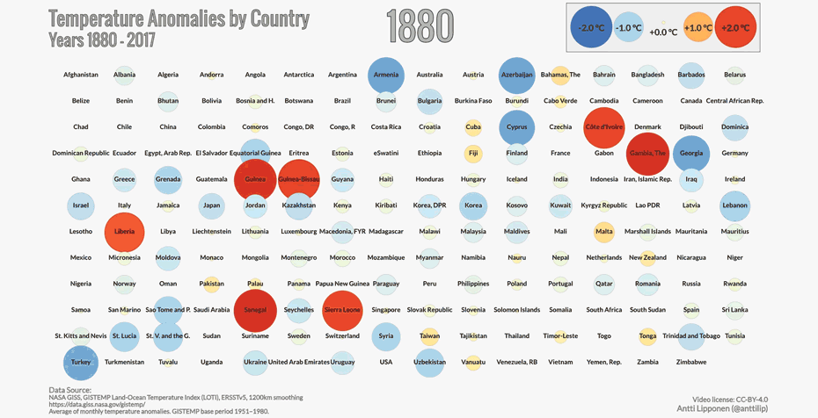
ANIMATION WITH TEMPORAL REFERENCE

Slide 16
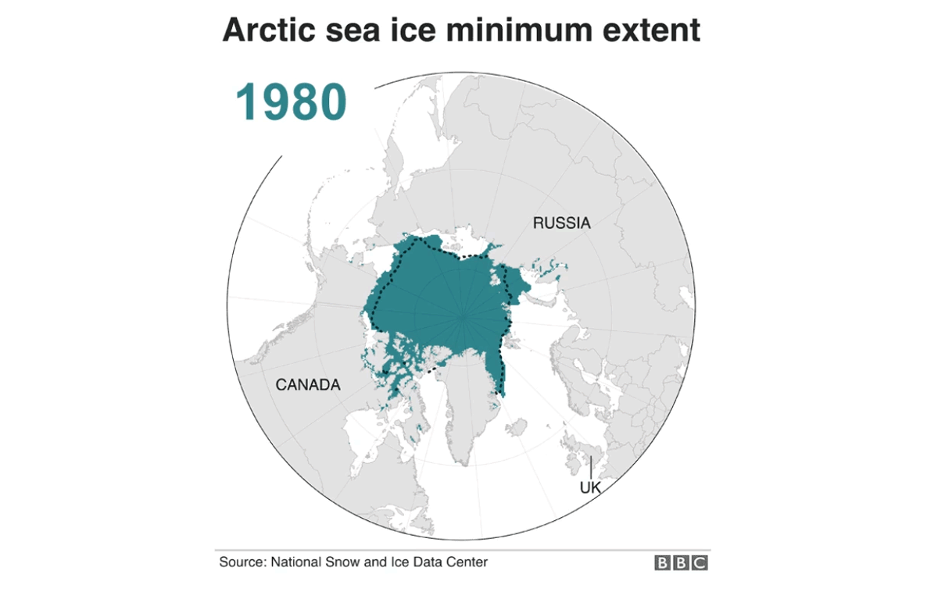
ANIMATION WITH TEMPORAL REFERENCE

Slide 17

ANIMATION WITH TEMPORAL REFERENCE

Slide 18
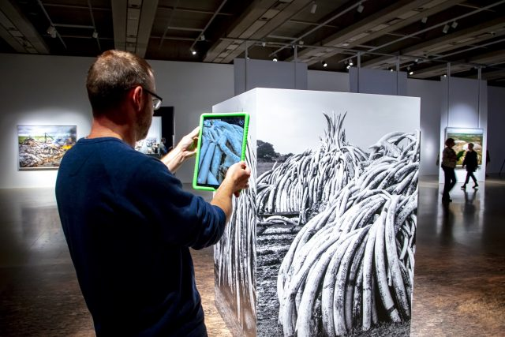
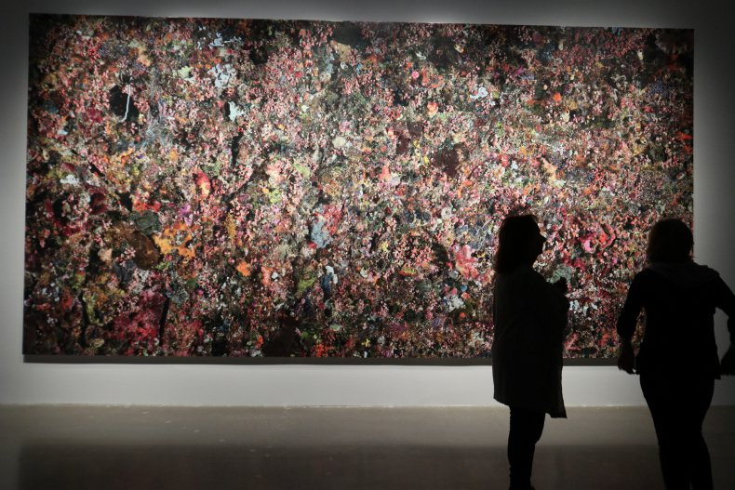
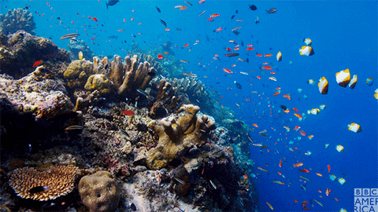
The Anthropocene – art gallery of Ontario

Slide 19
TO summarize
Data visualization is a powerful tool we can use to understand climate change and make an impact about climate change issues.
There are many types of data that can be used in a climate change data visualization and many of the challenges around their use revolve around what data to use and the visualization’s intended audience.
Data visualizations of climate data commonly show temporal changes, with 3D approaches being less common.

Slide 20
Thank you!

